Slide 1
Understanding requirements: Class-based model
PART-2

Slide 2
contents
Class model

Slide 3
Data Modeling
examines data objects independently of processing
focuses attention on the data domain
creates a model at the customer’s level of abstraction
indicates how data objects relate to one another

Slide 4
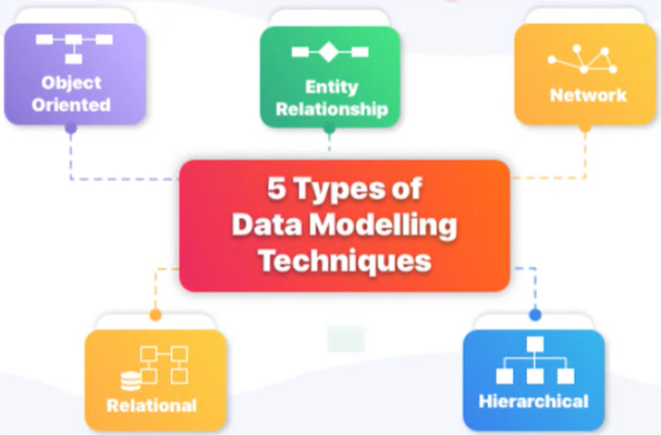
Types of Data Modeling

Slide 5
What is a Data Object?
a representation of almost any composite information that must be understood by software.
composite information—something that has a number of different properties or attributes
can be an external entity (e.g., anything that produces or consumes information), a thing (e.g., a report or a display), an occurrence (e.g., a telephone call) or event (e.g., an alarm), a role (e.g., salesperson), an organizational unit (e.g., accounting department), a place (e.g., a warehouse), or a structure (e.g., a file).
The description of the data object incorporates the data object and all of its attributes.
A data object encapsulates data only—there is no reference within a data object to operations that act on the data.

Slide 6
Data Objects and Attributes
A data object contains a set of attributes that act as an aspect, quality, characteristic, or descriptor of the object
object: automobile
attributes:
make
model
body type
price
options code

Slide 7
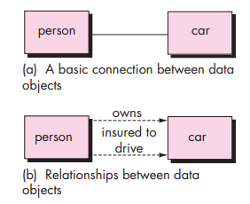
What is a Relationship?
Data objects are connected to one another in different ways.
A connection is established between person and car because the two objects are related.
A person owns a car
A person is insured to drive a car
The relationships owns and insured to drive define the relevant connections between person and car.
Several instances of a relationship can exist
Objects can be related in many different ways

Slide 8
ERD Notation
One common form:
(0, m)
object
relationship
object
1
(1, 1)
2
attribute
Another common form:
object
relationship
object
1
2
(0, m)
(1, 1)

Slide 9
The ERD: An Example
request
for service
Customer
places
(1,1)
(1,m)
(1,1)
standard
task table
(1,n)
work
order
generates
(1,1)
(1,1)
(1,1)
selected
from
work
tasks
(1,w)
(1,w)
consists
of
(1,i)
materials
lists

Slide 10
Class-Based Modeling
Class-based modeling represents:
objects that the system will manipulate
operations (also called methods or services) that will be applied to the objects to effect the manipulation
relationships (some hierarchical) between the objects
collaborations that occur between the classes that are defined.
The elements of a class-based model include classes and objects, attributes, operations, CRC models, collaboration diagrams and packages.

Slide 11
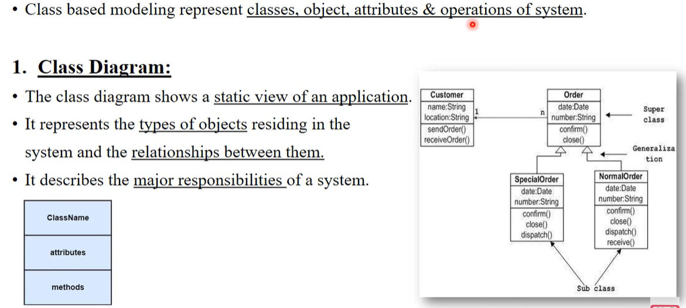
Contd.

Slide 12
Identifying Analysis Classes
Examining the usage scenarios developed as part of the requirements model and perform a "grammatical parse" [Abb83]
Classes are determined by underlining each noun or noun phrase and entering it into a simple table.
Synonyms should be noted.
If the class (noun) is required to implement a solution, then it is part of the solution space; otherwise, if a class is necessary only to describe a solution, it is part of the problem space.
But what should we look for once all of the nouns have been isolated?

Slide 13
Manifestations of Analysis Classes
Analysis classes manifest themselves in one of the following ways:
External entities (e.g., other systems, devices, people) that produce or consume information
Things (e.g, reports, displays, letters, signals) that are part of the information domain for the problem
Occurrences or events (e.g., a property transfer or the completion of a series of robot movements) that occur within the context of system operation
Roles (e.g., manager, engineer, salesperson) played by people who interact with the system
Organizational units (e.g., division, group, team) that are relevant to an application
Places (e.g., manufacturing floor or loading dock) that establish the context of the problem and the overall function
Structures (e.g., sensors, four-wheeled vehicles, or computers) that define a class of objects or related classes of objects

Slide 14
Potential Classes
Retained information. The potential class will be useful during analysis only if information about it must be remembered so that the system can function.
Needed services. The potential class must have a set of identifiable operations that can change the value of its attributes in some way.
Multiple attributes. During requirement analysis, the focus should be on "major" information; a class with a single attribute may, in fact, be useful during design, but is probably better represented as an attribute of another class during the analysis activity.
Common attributes. A set of attributes can be defined for the potential class and these attributes apply to all instances of the class.
Common operations. A set of operations can be defined for the potential class and these operations apply to all instances of the class.
Essential requirements. External entities that appear in the problem space and produce or consume information essential to the operation of any solution for the system will almost always be defined as classes in the requirements model.

Slide 15
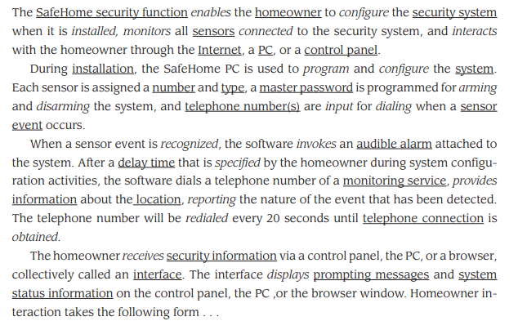
Example

Slide 16
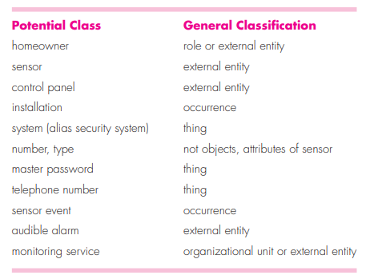
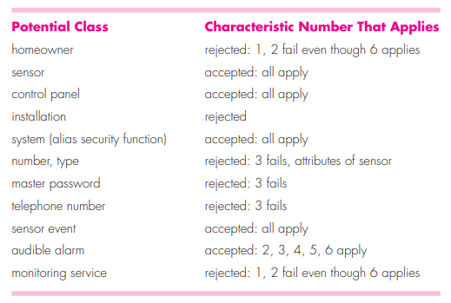

Slide 17
Defining Attributes
Attributes describe a class that has been selected for inclusion in the analysis model.
build two different classes for professional baseball players
For Playing Statistics software: name, position, batting average, fielding percentage, years played, and games played might be relevant
For Pension Fund software: average salary, credit toward full vesting, pension plan options chosen, mailing address, and the like.

Slide 18
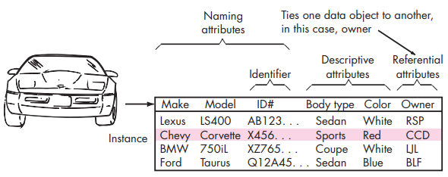
Contd…

Slide 19
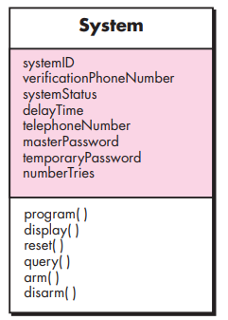

Specifying Attributes
The System class defined for SafeHome.
A homeowner can configure the security function to reflect sensor information, alarm response information, activation/deactivation information, identification information, and so forth. We can represent these composite data items in the following manner:

Slide 20
Defining Operations
Do a grammatical parse of a processing narrative and look at the verbs
Operations can be divided into four broad categories:
(1) operations that manipulate data in some way (e.g., adding, deleting, reformatting, selecting)
(2) operations that perform a computation
(3) operations that inquire about the state of an object, and
(4) operations that monitor an object for the occurrence of a controlling event.

Slide 21
CRC Models
Class-responsibility-collaborator (CRC) modeling [Wir90] provides a simple means for identifying and organizing the classes that are relevant to system or product requirements. Ambler [Amb95] describes CRC modeling in the following way:
A CRC model is really a collection of standard index cards that represent classes. The cards are divided into three sections. Along the top of the card you write the name of the class. In the body of the card you list the class responsibilities on the left and the collaborators on the right.

Slide 22
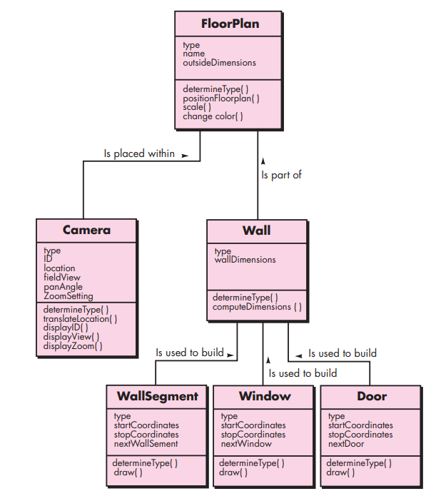

Slide 23
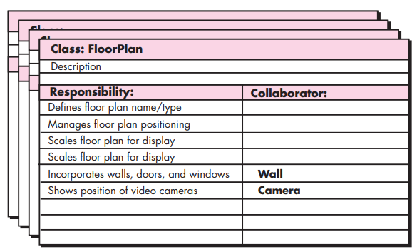
CRC Modeling

Slide 24
Class Types
Entity classes, also called model or business classes, are extracted directly from the statement of the problem (e.g., FloorPlan and Sensor).
Boundary classes are used to create the interface (e.g., interactive screen or printed reports) that the user sees and interacts with as the software is used.
Controller classes manage a “unit of work” [UML03] from start to finish. That is, controller classes can be designed to manage
the creation or update of entity objects;
the instantiation of boundary objects as they obtain information from entity objects;
complex communication between sets of objects;
validation of data communicated between objects or between the user and the application.

Slide 25
Responsibilities
System intelligence should be distributed across classes to best address the needs of the problem
Each responsibility should be stated as generally as possible
Information and the behavior related to it should reside within the same class
Information about one thing should be localized with a single class, not distributed across multiple classes.
Responsibilities should be shared among related classes, when appropriate.

Slide 26
Collaborations
Classes fulfill their responsibilities in one of two ways:
A class can use its own operations to manipulate its own attributes, thereby fulfilling a particular responsibility, or
a class can collaborate with other classes.
Collaborations identify relationships between classes
Collaborations are identified by determining whether a class can fulfill each responsibility itself
three different generic relationships between classes [WIR90]:
the is-part-of relationship
the has-knowledge-of relationship
the depends-upon relationship

Slide 27
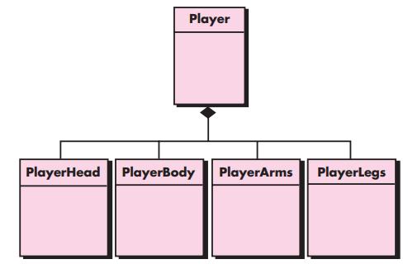
Composite Aggregate Class

Slide 28
Associations and Dependencies
Two analysis classes are often related to one another in some fashion
In UML these relationships are called associations
Associations can be refined by indicating multiplicity (the term cardinality is used in data modeling
In many instances, a client-server relationship exists between two analysis classes.
In such cases, a client-class depends on the server-class in some way and a dependency relationship is established

Slide 29
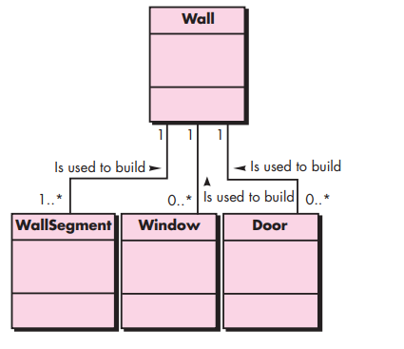
Multiplicity

Slide 30
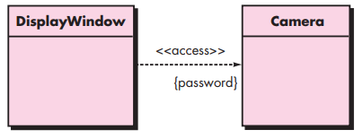
Dependencies

Slide 31
Analysis Packages
Various elements of the analysis model (e.g., use-cases, analysis classes) are categorized in a manner that packages them as a grouping
The plus sign preceding the analysis class name in each package indicates that the classes have public visibility and are therefore accessible from other packages.
Other symbols can precede an element within a package. A minus sign indicates that an element is hidden from all other packages and a # symbol indicates that an element is accessible only to packages contained within a given package.

Slide 32
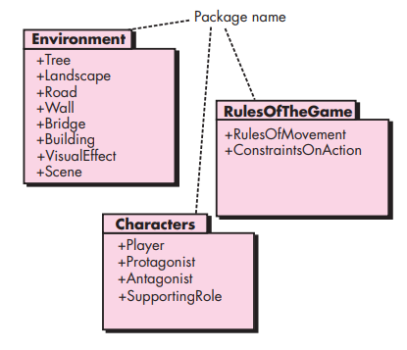
Analysis Packages

Slide 33
Reviewing the CRC Model
All participants in the review (of the CRC model) are given a subset of the CRC model index cards.
Cards that collaborate should be separated (i.e., no reviewer should have two cards that collaborate).
All use-case scenarios (and corresponding use-case diagrams) should be organized into categories.
The review leader reads the use-case deliberately.
As the review leader comes to a named object, she passes a token to the person holding the corresponding class index card.
When the token is passed, the holder of the class card is asked to describe the responsibilities noted on the card.
The group determines whether one (or more) of the responsibilities satisfies the use-case requirement.
If the responsibilities and collaborations noted on the index cards cannot accommodate the use-case, modifications are made to the cards.
This may include the definition of new classes (and corresponding CRC index cards) or the specification of new or revised responsibilities or collaborations on existing cards.

Slide 34
Thank you!!!

